Slide 1
Sub: General English
UG Second Year Title: Shyness My Shield
-M.K.Gandhi

Slide 2
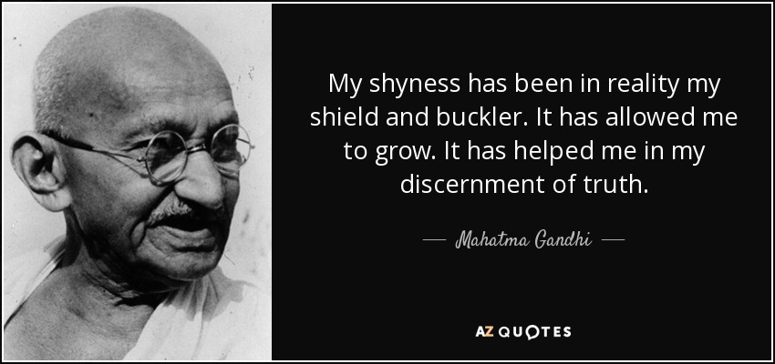
Department of English P.R.Government College(A), Kakinada

Slide 3
Autobiography of Gandhi

Slide 4
SHYNESS MY SHIELD
-M.K.GANDHI

Slide 5
About the Title
Shyness refers to social anxiety or social phobia (students shyness)
A feeling of discomfort in public or to speak in public
Shield refers to a broad piece of metal or another suitable material used as a protection against blows

Slide 6
How…….?
How Gandhi made his shyness as a shield?

Slide 7
SLOTS
Lesson Language STT & CLTT
SHYNESS MY SHIELD

Slide 8
MOHANDAS KARAMCHAND GANDHI(1869-1948)
Gandhi is not only for India a hero of national history but of the World – Romain Rolland, French writer

Slide 9
ABOUT THE WRITER
Preeminent leader
Apostle of Truth
Led Non-Violence and Civil Disobedience Movements
Nominated for noble peace prize
‘Mahatma’, ‘Bapu’ , ‘Father of the Nation’.

Slide 10
STATESMAN OF THE WORLD

Slide 11
BIOGRAPHY -AUTOBIOGRAPHY
Two traditional forms of literature
character sketch and course of life of a person
Biography | Autobiography
Life history of an individual written by someone eg: Swamy Nikhilananda’s ‘Vivekananda: A Biography | Life history of an individual life, written by self. eg: Hellen Keller’s ‘The Story of My Life’

Slide 12
GANDHI’S AUTOBIOGRAPHY

Slide 13
MY EXPERIMENTS WITH TRUTH
Classic of modern times
Honest record of personal experiences Originally written in Gujarathi Translated into English by Mahadev
Desai

Slide 14
ABOUT THE LESSON
Chapter Eighteen of Part-I and Volume I of Gandhi’s autobiography
Candid narration of Gandhi’s efforts to speak in public
His shyness helped him to know the discernment of truth and spiritual discipline

Slide 15
GANDHI IN VEGETARIAN SOCIETY IN
LONDON
TONGUE - TIED
SAT SILENT
UNABLE TO EXPRESS
Elected to the Executive Committee
DRONE

Slide 16
Drone
Dr.Oldfield once said to me, “You talk to me quite all right, but why is it that you never open your lips at a committee meeting?
You and me also experience the same

Slide 17
Arguments
Mr.Hills
Dr.Allison

Slide 18
TIME FOR DISCUSSION
Gandhi set down his thoughts in writing to support Dr.Allison
Lack courage to speak/read
Felt cowardice to register a silent vote
Resigned from the committee.

Slide 19
GANDHI’S SHYNESS
His shyness retained throughout his stay in England
“Even when I paid a social call, the presence of half a dozen or more people would strike me dumb.”
“To speak extempore would have been out of the question for me.”

Slide 20
Gandhi about his shyness

Slide 21
AT VENTNOR, A SEA-SIDE RESORT
At Ventnor met Mr .Howard, the author of ‘The Ethics of Diet’
Gandhi was invited to speak at a meeting for promotion of vegetarianism

Slide 22
AT VENTNOR…….
Prepared speech on paper but could not read it
His vision blurred and he trembled to speak
Sjt. Mazumdar had read it.
Gandhi feels…
“I was ashamed of myself and sad at heart for my incapacity

Slide 23
HOLBORN RESTAURANT

Slide 24
G ANDHI’S LAST EFFORT IN ENGLAND
On the eve of his departure to India arranged a party at Holbourn Restaurant.
Non-vegetarian Restaurant strictly with vegetarian meal
Vegetarians felt this experiment with new delight
Gandhi prepared a humorous speech with an anecdote

Slide 25
Ridiculous
Gandhi began the speech but felt nervous and tongue-tied.
Memory failed
“I thank you Gentlemen, for having kindly responded to my invitation, said abruptly and sat down.
He succeeded in making himself ridiculous

Slide 26
SHYNESS AS HIS SHIELD
In South Africa, however, he overcame his shyness
shyness as an advantage
Economy of words Restrained his thoughts Spiritual discipline
Self-Introspection
“My shyness has been in reality my shield and buckler”
“silence is part of the spiritual discipline of the votary of truth”

Slide 27
LANGUAGE ACTIVITY
Glossary
Vocabulary
Imagery
Idioms

Slide 28
GLOSSARY
Banter- making fun of someone in a friendly way
Protege – a follower or disciple
Eclat – style
Discernment – wisdom
Conceive – imagine or think
Ridiculous – laughable

Slide 29
VOCABULARY
Kinds of Speech delivery 1.Impromptu – prepared speech
Eg: Independence day speeches, Elocution Competition speeches
2.Extempore - spoken without preparation

Slide 30
3.Manuscript - reading a pre-written speech
4.Memorized - memorizing the information

Slide 31
Pre-Listening Activity/ Post Listening Activity
“ I have never given an extempore speech.”
Students feel shy to present an extempore speech

Slide 32
IMAGERY
Figurative use of language
The bees are very busy, the drone is a thorough idler
My shyness has been in reality my shield and buckler

Slide 33
IDIOMS WITH ‘TONGUE’
Tongue-tied
Hold your tongue
Slip of the tongue
Keep a civil tongue - terms
Tongue in cheek - funny or ironic

